Slide 1
Development of master curricula for natural disasters risk management in Western Balkan countries
How to improve quality of promotions of trainings (LLL courses) and students enrolment – EU experience
Kurt Glock
University of Natural Resources and Life Sciences BOKU, Vienna
Fifth Quality Assurance Committee meeting/ 20th March 2019
Project number: 573806-EPP-1-2016-1-RS-EPPKA2-CBHE-JP
"This project has been funded with support from the European Commission. This publication reflects the views only of the author, and the Commission cannot be held responsible for any use which may be made of the information contained therein"

Slide 2
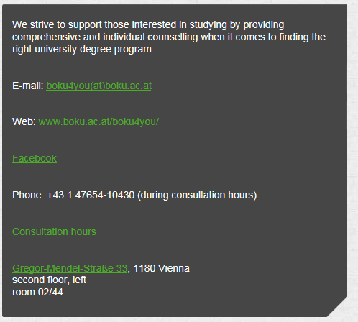
How to improve quality of promotions of students enrolment?
Development of master curricula for natural disasters risk management in Western Balkan countries
Student Advisory Service

Slide 3
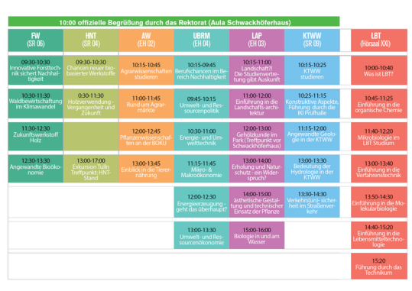
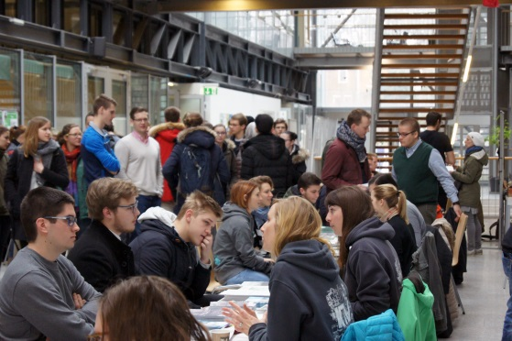
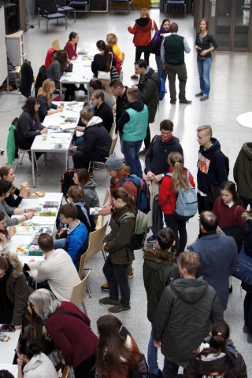
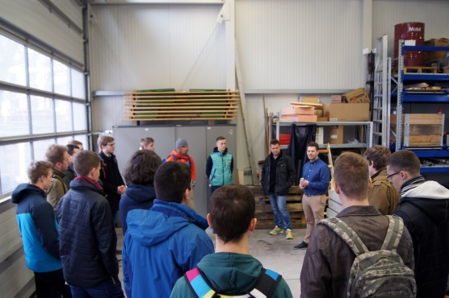
How to improve quality of promotions of students enrolment?
Development of master curricula for natural disasters risk management in Western Balkan countries
Student Advisory Service Open House and Info Day for Prospective Students
When? 12th April 2019 10 a.m. – 16 p.m.
Where? Hall, Schwackhöferhaus (BOKU)
What to expect?
Taster courses, discussions with students, information on study programs, international master's programs advisory service, guided tours through laboratories and the campus, social counselling services, etc.

Slide 4
How to improve quality of promotions of students enrolment?
Development of master curricula for natural disasters risk management in Western Balkan countries
Student Advisory Service Career Orientation Fairs and School Visits
When? 7th to 10th March 2019 9 a.m. – 18 p.m.
Where? Vienna (additionally Graz, Klagenfurt, Salzburg, Innsbruck)
Organizer?
BeSt³ is jointly organized by the Austrian Federal Ministry of Education, Science and Research (BMBWF) and the Austrian Employment Service (AMS).
What to expect?
Information hub and contact point
~40.000 high school graduates
The largest education fair in Austria

Slide 5
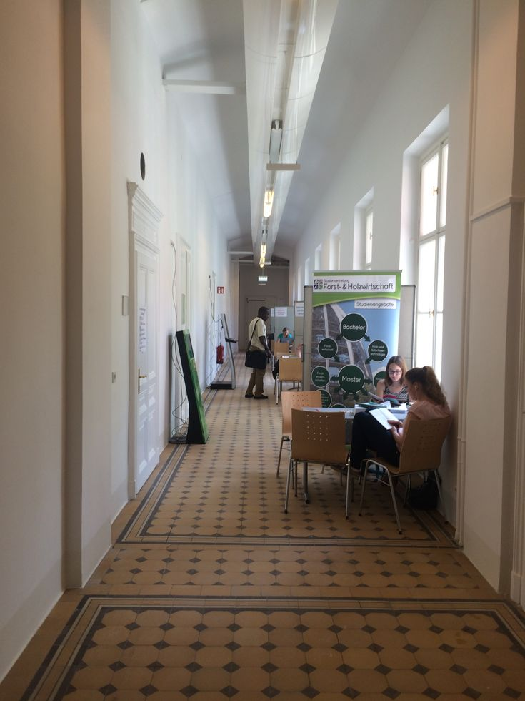
How to improve quality of promotions of students enrolment?
Development of master curricula for natural disasters risk management in Western Balkan countries
Student Advisory Service Introductory Counselling within the General Admission Period
Guided tours at the BOKU
Provided by the Austrian Students` Union at BOKU (ÖH-BOKU)
Special appointments
Attuned to foreign students
Offered for winter and summer term
Target group: school classes (16 – 19 years)
Introduction of the University
Tour through the Campus
Information about registration, bachelor programs, etc.

Slide 6
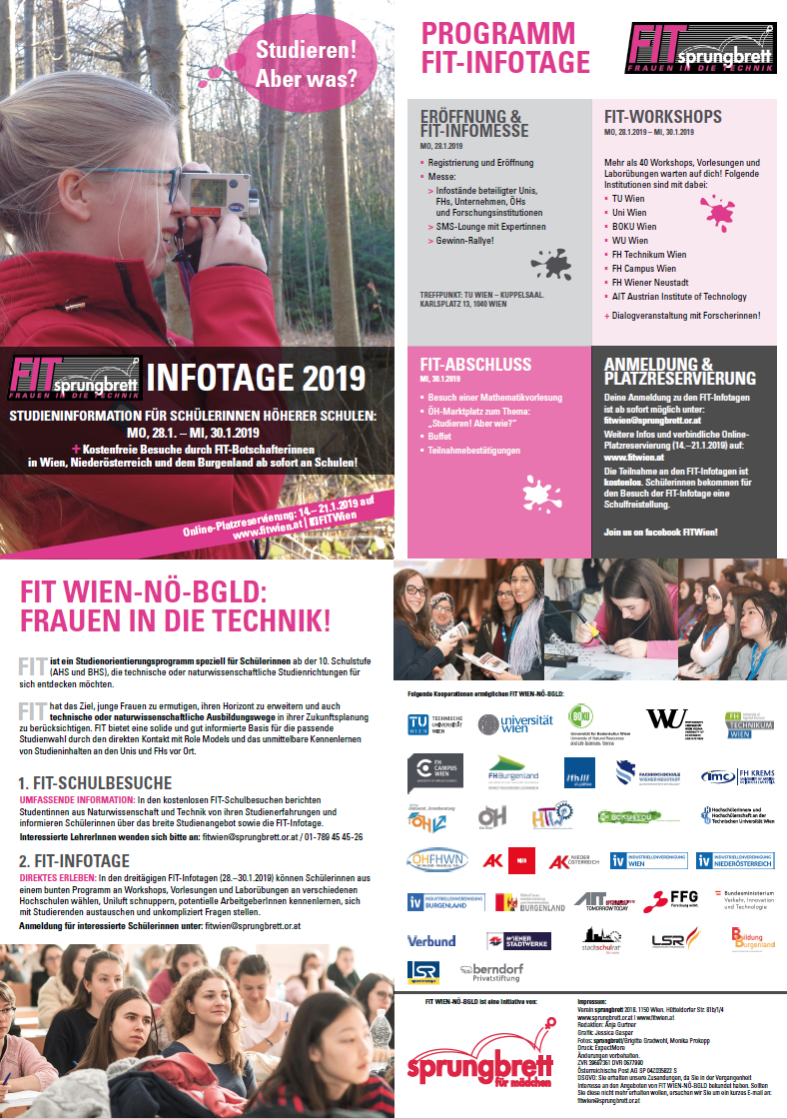
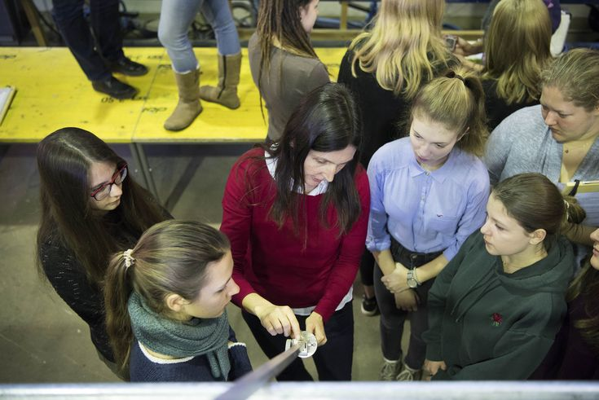
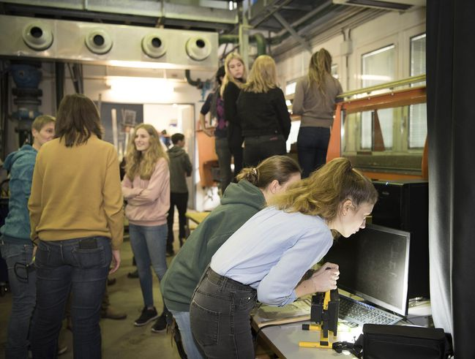
How to improve quality of promotions of students enrolment?
Development of master curricula for natural disasters risk management in Western Balkan countries
Student Advisory Service FIT – Frauen in der Technik (“Women in engineering”)
When? 27th to 29th January 2020
Where? Vienna
Participants?
Special offer for female students from the 10th grade

Slide 7
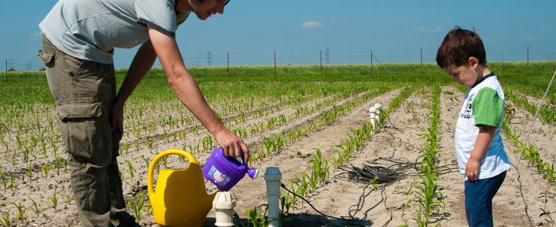
How to improve quality for promotion of LLL?
Development of master curricula for natural disasters risk management in Western Balkan countries
Lifelong Learning and Continuing Education
The BOKU is also a society partner in the field of natural resources and applied life sciences.
Lifelong learning is an important part of the overall task of the University of Natural Resources and Life Sciences.
OFFICE
Head: Mag. Christina Paulus
Address & Contact: H11.230 Lifelong Learning and Continuing Education
Adolf Cieslar Haus
Peter-Jordan-Straße 70/II
1190 Vienna

Slide 8
How to improve quality for promotion of LLL?
Development of master curricula for natural disasters risk management in Western Balkan countries
Lifelong Learning and Continuing Education Projects (selected)
LifeADA – Lifelong Learning for sustainable agriculture in Alps-Danube-Adriatic Region
LaWEEEDA – Latin American-Euopean network on waste electrical and electronic equipment research, development and analyses (Erasmus+ Project)
We4DRR – women exchange for disaster risk reduction
VNFIL – Transnational Peer Review for quality assurance in Validation of Non Formal and Informal Learning (Erasmus+ Project)
http://lifeada.agr.hr/
http://www.naturgefahren.at/eu-internationales/we4DRR.html
http://www.peer-review-network.eu/pages/peer-review-vnfil-extended.php?lang=EN

